Slide 1
Sonic Weapons
Group name: ASI(Asjid, Subhani, Ibrar ) Members id: P19-0085 ( Asjid Tahir)
P19-0084(Hassan Subhani)
P19-0104(Ibrar Babar)

Slide 2
What are Sonic Weapons:
Sonic Weapons are those weapons which uses supersonic waves instead of bullets are named as Sonic Weapons.
Sonic Weapons are describes as:
Sonic Bullets.
Sonic Grenades.
Sonic Mines.
Sonic Cannons.
Sonic Weapons are actually based on the principle of supersonic waves or Ultrasonic waves.

Slide 3
Supersonic Waves:
Supersonic travel is a rate of travel of an object that exceeds the speed of sound .
Supersonic waves are also named as Shock waves.
The supersonic waves or ultrasonic waves is like a cone waves because their shape is like a cone.
They are also known as Hypersonic waves.

Slide 4
Frequency Range:
Sonic Weapons are those how’s frequency are more than the earing frequency of humans.
Frequency of human earing is 20 Hz to 2000 Hz.
Frequency by sonic weapons are too much high.
Most of the weapons function between the frequency range of about 1 Hz to 30 KHz.

Slide 5
Example of Supersonic Waves:
A JET is an example if supersonic waves.
Because Jet travel more then the speed of sound waves.
It produce supersonic waves around there and these waves are so dangerous that it can destroy a building.

Slide 6
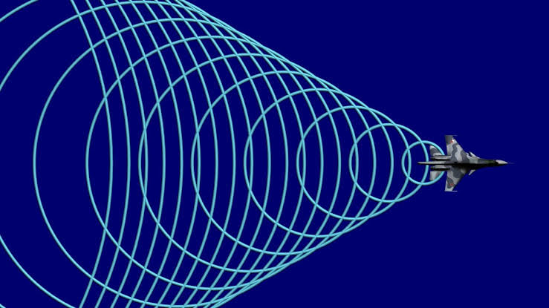

Slide 7
USES OF SONIC WEAPONS :
Sonic and Ultrasonic weapons are weapons of various types that use sound to injure, incapacitate or kill opponent.
Some sonic weapons are currently in limited use or in research and development by military and police forces.
Lips reading.
Chinese & USA mini sonic weapons.

Slide 8
Frequency Ranges:
Below 20 hertz.
Sonic knife.

Slide 9
Disadvantages:
High powered, low frequency sound from about 30 Hz to about 100 Hz causes the following biological effects:
Blurred vision.
Stomach Pain & Vibration in brain.
Pain or damage to internal organs and burn human cells.

Slide 10
Example:
Earthquake is an example of ultrasonic waves.
When earth quack come, resonance of unstable buildings match with the resonance of waves and amplitude of building increase.
So due to this reason building fall down.

Slide 11
Effects:
Studies have found that exposure to high intensity ultrasound at frequencies from 700 kHz to 3.6 MHz can cause lung and intestinal damage in mice.
It can also effects and damages ear drum and causes severe pain and disruption.
Hearing loss.

Slide 12
Effects:
Infrasonic generators can cause negative emotions such as:
fear,
anxiety,
or depression,
It is a device which could also target the brain.
These changes in brain frequencies cause changes in brain chemistry, which then influence thoughts and emotions.
Furthermore, transmitting directed-energy using an exact frequency and modulation will trigger a precise chemical reaction in the brain, which, in turn will produce a specific emotion in the targeted individual.

Slide 13
Example:
In japan a person made a bridge.
And he don’t manage the frequency of bridge.
Resonance of bridge match with resonance of sound of waves of air.
Amplitude rise up.
And bridge fall down.

Slide 14


Slide 15
Questions?
Thank You!

